Slide 1
PID Algorithm

Slide 2
Before we start solving the grid we need to learn how to follow lines properly.
We have :
Sensors to detect the line
Motors that we can control

Slide 3
Sensors
Use ready-made Pololu QTR-8RC Array Sensor
OR
Build your own sensor array.

Slide 4
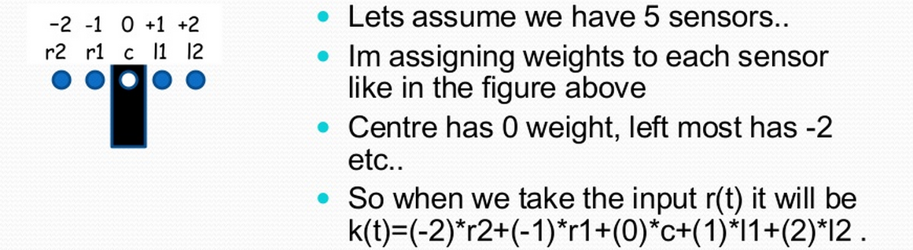

Slide 5
Goal
Center of bot = center of line
ie, Value = 0

Slide 6
KEY TERMS IN PID BASED LINE FOLLOWING:
PID stands for Proportional, Integral and Derivative.
The proportional value is approximately proportional to your robot’s position with respect to the line. That is, if your robot is precisely centered on the line, we expect a proportional value of exactly 0.
The integral value records the history of your robot’s motion: it is a sum of all of the values of the proportional term that were recorded since the robot started running.
The derivative is the rate of change of the proportional value.

Slide 7
Proportional:
r(t) = (-2)*r2 + (-1)*r1 + 0*c + (1)*l1 + (2)*l2
r2 + r1 + c + l1 + l2
Too far right – negative
Too far left – positive
Desired value = 0

Slide 8
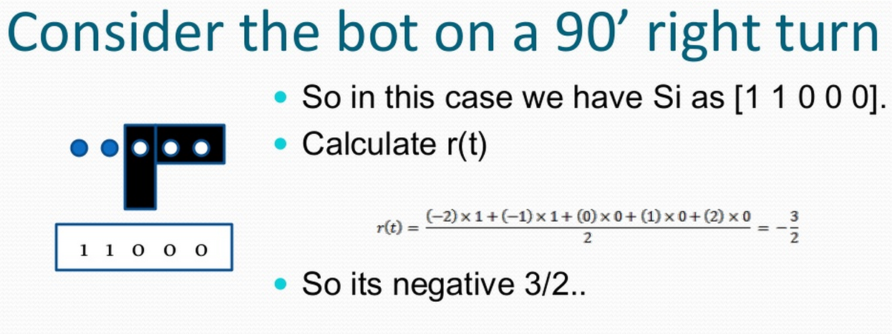

Slide 9
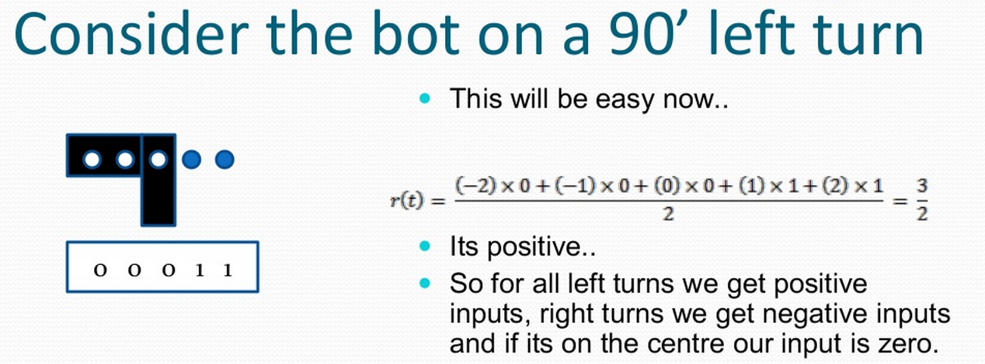

Slide 10
The terms in PID
e_prop = Kp*r(t)
e_diff = Kd*(e – e_prev)
e_int = Ki*(e_int + e)
diff or derivative is the change in error
int or integral is the accumulated error

Slide 11
Algorithm
Read sensors
Calculate r(t)
e_prop = Kp*r(t)
e_diff = Kd*(e – e_prev)
e_int = Ki*(e_int + e)
e_prev = e
MotorSpeed = e_prop + e_diff + e_int
RightMotorSpeed = RightBaseSpeed + MotorSpeed;
LeftMotorSpeed = LeftBaseSpeed - MotorSpeed;
repeat

Slide 12
Troubles you may run into:
Errors in sign:
White line on black surface
Black line on white surface
Finding Kp, Kd, Ki values
start small. Pwm = 100
first adjust Kp (Kd = 0, Ki =0) – bot will oscillate
increase Ki until oscillations subside
finally adjust Kd for overshoots

